Slide 1
Tax Strategies Under the New Section 199A
California Lawyers Association
April 19, 2018
 |  | Cameron L. Hess Wagner Kirkman Blaine Klomparens & Youmans LLP chess@wkblaw.com (916) 920-5286

Slide 2
Quick Overview
Former Section 199 – Domestic Production Deduction
  9% Deduction (phased in) – through 2017
  Production Activity (*Starbucks - ground coffee sales.)
  9% of lesser of QPAI or TI; 50% wage limit
  IRS Form 8903 DPAD (individuals, Corps, trusts/estates)
  Expenses deductible against DP Gross Receipts
    Partner/S Corp - basis, at-risk, and PAL limits D
    Allocate expenses between DPGR vs NonDPGR
Notes:
Common categories include – (i) manufacture, production, growth or extraction (MPGE) of tangible personal property, in whole or in significant part within the U.S. (which for tax years beginning before Jan. 1, 2010, could in some circumstances include Puerto Rico—see section 199(d)(8)); (ii) construction of real property in the U.S.; and (iii) performance of engineering or architectural services in the U.S. in connection with real property construction projects in the US. Preparation of food and beverages for retail sale is not eligible for the deduction, nor are activities that are purely services, outside the fields of construction, engineering and architecture.

Slide 3
Quick Overview
New §199A (Tax Cuts and Jobs Act)
  Former §199 Repealed
  Broadly Expands Deduction - all business income
  C Corp’s ineligible
20% Deduction for Qualified Business Income Amount

Slide 4
General Provisions
Unchanged - Basic Rules
  Deduction – (now 20%, formerly 9%)
  % x lesser: (i) QBIA or (ii) TI of business (AGI for individ.)
  50% W-2 wage limit (but new options)
  Specific services excluded – except architects/engineers (but new exception)
  Pass-through entities - pass benefits through.

Slide 5
General Provisions
Changes
  All trade/business activities eligible if not specified services (not just “production”)
  Alternatives to 50% Wage Limit
    25% wage + 2.5% qualified property basis limit
    Small Taxpayer Exception - no limit
  C Corporations ineligible (21% tax rate instead)

Slide 6
General Provisions
Qualifying Businesses
  Trade or Business
  Carried on by Taxpayer
  Activities within the United States
  Excludes Specified Services
    Not §1202(e)(4) Services (except architects/engineers)
    Not investment management (See Lenders), trader/dealer in securities, commodities.
    Small Taxpayers can engage in §1202(e)(4) Services (investment managers/traders/dealers never eligible)

Slide 7
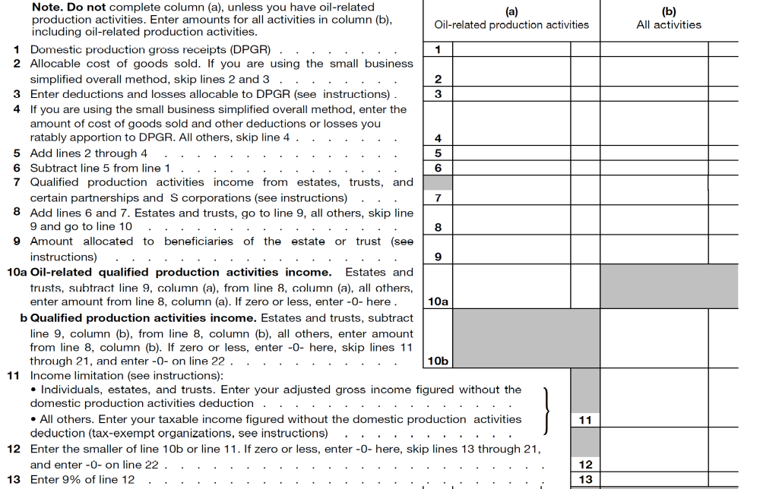
Former Form 8903 (lines 1 – 13)

Slide 8
Predicted New Form (Pt 1)NOT ACTUAL FORM
1. | Qualified Business Activities Income (from worksheet 1) | 1.
2. | Qualified Business Income from Estates, Trusts and certain partnerships & S Corporations (from worksheet 2)
 |  | 2.
3. | Add lines 1 and 2. Estates and trusts, go to line 4, all others skip line 9.
 |  | 3.
4. | Amount allocated to beneficiaries of the estate or trust (see instructions)
 |  | 4.
5. | Add lines 3 and 4. | 5.
6. | Income limitation:  Individuals, estates and trust. Enter your adjusted gross income computed without the qualified business income deduction.  All others. Enter your taxable income figured without the qualified business income deduction.
 |  | 6.
7. | Enter the smaller of line 5 or 6. If zero or less, enter zero. | 7.
8. | Enter 20% of line 7 | 8.

Slide 9
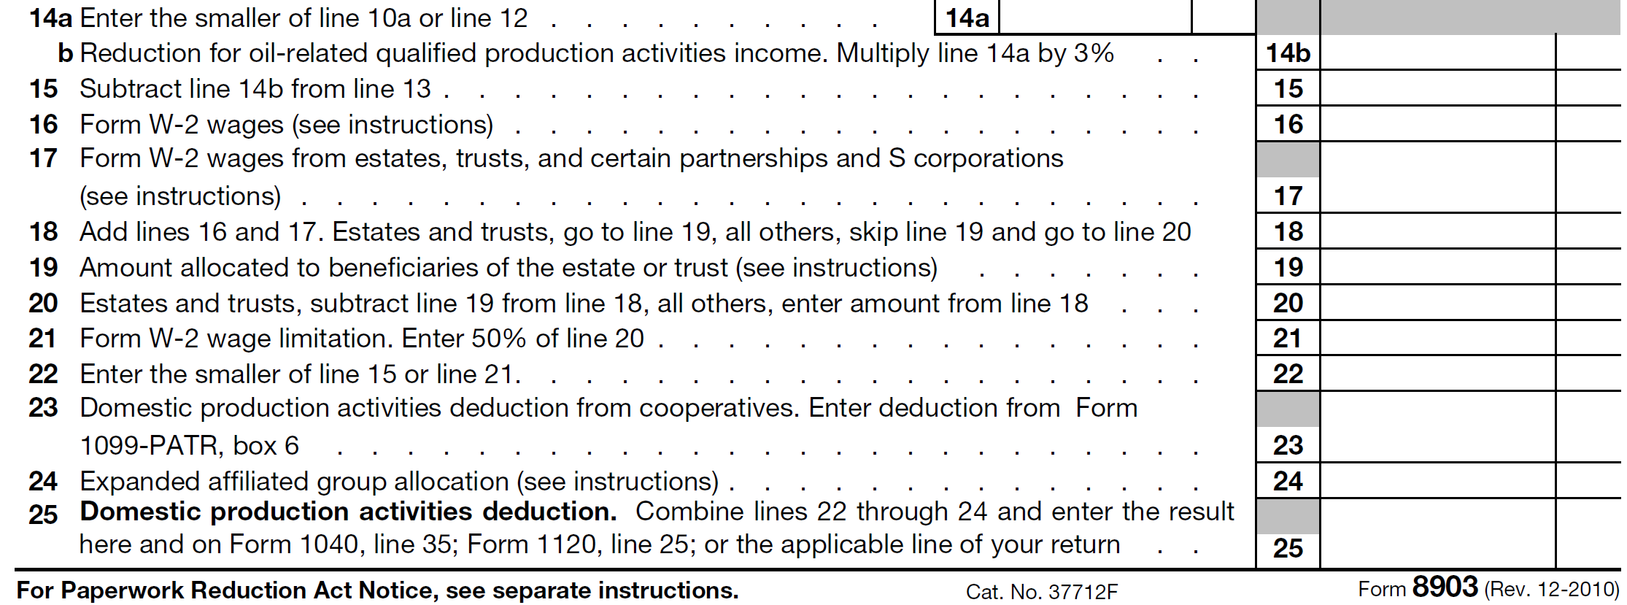
Former Form 8903 (lines 13-225)

Slide 10
Predicted New Form (Pt 2)-Not Actual Form
9.a | Form W-2 Wages | 9a.
b. | Form W-2 wages from estates, trusts and certain partnerships and S Corporation (see instructions) | b.
10. | Add lines 9a and 9b. Estates and trusts go to line 11, all others, skip line 10 and go to line 12 |  | 10.
11. | Amount allocated to beneficiaries of the estate of trust |  | 11.
12. | Total Wages. Estates and trusts, subtract line 19 from line 18, all others enter the amount from line 18 |  | 12.
13. | Form W-2 Wage Limitation. Enter 50% of line |  | 13.
14.a | Basis in Qualified Property (See Instructions) | 14a
b. | Multiply Line 14.a by 2.5% | b.
c. | Multiply Line 12 by 25% | c.
15. | Basis + W-2 limitation Add lines 14a and 14b. |  | 15
16. | Enter Taxable Income Before QBI Deduction | 16.
17. | Small Taxpayer Exception  If line 16 is less than 157,500 ($315,000 married, filing jointly), enter line 8.  If line 16 is greater, but less than $207,500 ($415,00 married filing jointly), enter amount from worksheet 3)  Otherwise, skip line 17
 |  |  | 17.
18. | All Others. If line 17 is inapplicable, enter the greater of line 13 and line 15 |  | 18.
19. | Enter Line 17 or line 18 |  | 19.
20. | Enter the smaller of line 8 or 19. |  | 20.
21. | QBI deduction from Cooperatives (Form 1099-PATR, box 6) |  | 21.
22. | QBI deduction from Real Estate Investment Trusts (Form 1099-REIT, box 6) |  | 22.
23. | QBI deduction from publicly traded partnerships (See instructions) |  | 23.
24. | Qualified business income deduction. Combine lines 20 through 23 and enter the result here and on Form 1040, line 35; or the applicable line of your return
 |  |  | 24.

Slide 11

Trade or Business
Any qualified trade or business
  Special Treatment:
    Qualified REIT Dividends (covered elsewhere)
    Qualified Co-Op Dividends (covered elsewhere)
    Qualified PTP Income (covered elsewhere)

Slide 12
General Provisions
Specified Services Exclusion
  §1202(e)(2). Services excluded from 1202, but architects & engineers are okay (US for projects).
  Excluded: Health, law, accounting, actuarial science, performing arts, consulting, athletics, financial services, brokerage services or personal reputation/skill services.
Small taxpayer exception: Specified Services allowed
  Less than $207,500 taxable income($415,000–joint return)
  Phase-out if taxable income > $157,500 ($315,000).

Slide 13
Qualified Business Income
Qualified Business Income – net income of a qualified business.
Qualified Items: Income, loss, gain, deduction effectively connected with conducting trade or business in the US
    Follow 864(c)
    Excludes:
      Capital Gains/Losses
      Dividends
      Interest
      Annuity
      Certain foreign PHC income (commodities, foreign currency exchange, notational hedging contracts (hedging)

Slide 14
Qualified Business Income
Qualified Business Income – Adjustments.
Exclude/Deduct (reduces QBI):
  Reasonable compensation* paid to the taxpayer by a qualified trade/business for services rendered.
  Guaranteed payments to a partner for services
  Other payments to a partner for services.
IRS may adjust if too high/low to reduce QBIA/Wages.

Slide 15
Trade or Business Concepts
Trade or Business
  Not defined by statute/regulations
  Section 469 does not control
  Common Law Concept - Case Law (examples)
    Determining effectively connected income
    Determining business loss
    Partnership vs Co-tenancy
  Ripe for litigation by IRS

Slide 16
Trade or Business
Case Law - Definition
Activities must be regular, systematic and continuous
  Alvery, (2nd Cir 1962) 302 F.2d 790 Apartments = Trade or Business. Loss on nationalized business.
  Lender Management, LLC (Dec. 13, 2017) T.C. Memo 2017-246. Family investment group = Trade or Business. Court will look to staff & activities, even if activity is inherently investments. (Lender family – aka Lender’s Bagels)

Slide 17
Trade or Business
Rentals Held Not a Trade or Business
  Herbert, 30 T.C. 26 (1958). Single rental – no activity
  Anderson, T.C. Memo 1982-576. Farm leased to tenant.
  Grier, 120 F. Supp. 395 (D. Conn 1954) Inherited rented home – sometimes used agent – no regular activity.
  Rev. Rul. 73-374, 1975-1 C.B. 261 – 3rd party manages real prop (multifamily) for co-owners. (no partnership)
But courts often disagree with IRS

Slide 18
Trade or Business
Rentals Recognized as a Trade or Business
  Balsamo, T.C. Memo 1875-477. Single rental property.
  Curphey, 73 T.C. 766 (1980). Dermatologist personally managed 6 rental properties in Hawaii.
  Leweenhaup, 20 T.C. 151 (1951), aff’d 9th Cir 221 F.2d 227 – 3rd party managed real property for single owner.
  Gifford, 201 F.2d 753 (2nd Cir. 1953). 2 sisters with 8 apartments. Real estate agent managed for them.
  Murtaugh, T.C. Memo 1997-319. 25% time share in 2 condos. 3rd party management company handled time shares.

Slide 19
Trade or Business
“By Taxpayer” includes activity by or on behalf of taxpayer (agents count) - if regular, systematic, continuous.)
  If agency law applies, do all mere investors in a trade or business qualify for Section 199?
“Taxpayer”, includes under Section 199A attribution due to pass-through entities – S Corporations/LLCs, partnerships.

Slide 20
Wages/Basis Limit
Limit:
Tentative QBI Deduction Amount is limited to the greater of:
50% Qualified Wages
25% Qualified Wage + 2.5% Qualified Property Basis
Small Taxpayer Exception (no limit)

Slide 21
Wage Limit
50% Wage Limit (old Section 199 rule continued)
  50% of W-2 Wages (for the qualified business)
  Paid with respect to employment of employees
Which Wages Count? (1.199-2(c))
  W-2 Reported.
    Include Wages of Affiliate if for business
    Wages of Agent sometimes count.
  Not Wages: A management fee, i.e. 5%

Slide 22
Wage Limit
Employee for Which Taxpayer?
1.199-2(c) – former DPAP regulations
a taxpayer may take into account any wages i) paid by another entity and ii) reported by the other entity on Forms W-2 with the other entity as the employer listed in Box c of the Forms W-2
provided that the wages were paid to employees of the taxpayer for employment by the taxpayer.

Slide 23
Wage Limit
1.199-2(c)
If the taxpayer is paying wages as an agent of another entity to individuals who are not employees of the taxpayer, the wages may not be included in determining the W-2 wages of the taxpayer.
Who does an on-site resident manage work for (where 3rd party manager?...unclear. Nationwide Mut. Ins. Co. v. Darden, 503 U.S. 318 (1992) – facts & circumstances.

Slide 24
Wage Limit
Who is an Employee? – Follow common law.
Example: Joint Employment (both deemed employers)
L.R.B. v. Browning-Ferris Indus. of Pa., 691 F.2d 1117, 1123-24 (3d Cir. 1982)
• Authority to hire and fire;
• Authority to promulgate work rules, assignments and set conditions of employment: compensation, benefits, and work schedules, including the rate and method of payment;
• Involvement in day-to-day supervision/discipline; and
• Actual control of employee records *payroll, insurance, taxes.

Slide 25
Wage + Basis Limit
Alternate: 25% Wage & 2.5% Basis Limit (new)
  Limit: Sum of both (i) 25% wages + (ii) 2.5 % qualified business property unadjusted basis.
Qualified Business Property (cost/gift/inherited basis)
  Used in trade or business
  Subject to 167 depreciation (but no reduction
  Counted over the longer of
    i) Section 168 recovery (to last day of “full year”) or
    ii) 10 years from 1st in service (to last day of “full year”)

Slide 26
Wage + Basis Limit
Alternate: 25% Wage & 2.5% Qualified Prop. Basis (new)
Qualified Business Property
  Available for use through last day of year
  Actually used sometime during year (one time rule)
  Depreciable period does not end before year-end. (Can use 10-year instead of Section 168)
  Therefore – don’t count if disposed or period ended before year end or idle 365 days.

Slide 27
Wage + Basis Limit
Qualified Business Property
  Coordinate with New Depreciation Rules – Still Count:
  Include for 2.5% -
    Basis of Property Subject to Bonus Depreciation
    Basis of Property Subject to 179 First Year Depreciation
  Might Not be Allowed to Add Back:
    DeMinimis Write-off (items under $2,500) – (treated as repair)
    Deductions for replacements (if treated as repiar)

Slide 28
Wage + Basis Limit
Example - Qualified Property – 2.5% Limit
Dr. Jake, single has 4 rentals and > 207,500 TI. He actively manages (no employees) Reviewing 2009-2018 returns, his wage ($0)/qualified property limit is $9,125
Descript | Pur Date | Basis | Acc Deprc’n | Allowable | 2.5%
Buildings | 3/7/2005 | 300,000 | (100,000) | 300,000 | $7,500
Carpet (7-yr) | >1/1/2009 | 30,000 | (23,000) | 30,000 | 750
Carpet (7yr) | <1/1/2009 | 15,000 | (15,000) | 0 | 0
Land Imp 15yr | >2003 | 35,000 | (17,000) | 35,000 | 875
TOTAL – 2.5% | 2018-Year | Limit |  |  | $9,125

Slide 29
Small Taxpayer Exception
Alternate: Small Taxpayer Exception (new)
No Wage or Wage + Basis Limit
Most Special Service Enterprises Qualify
  199A(d)(3)(A)(i) – allows (d)(2)(A) – professional services only.
  But NOT investment managers, traders, dealers
Subject to phase-out.
Examples
    Lawyers/Doctors/Accountants
    Financial Planners
    Real Estate Brokers

Slide 30
Small Taxpayer Exception
Small Taxpayer: Taxable Income (NOT AGI) Limited
  $157,500 ($315,000 joint return) - aka Threshold.
% Phase Out of Exception (partly subject)
  $ 50,000 over threshold (single/head of household)
  $100,000 over threshold (married filing joint)
  E.g., Single @ $182,500 TI = 50% (25k/50k) subject to one of 2 wage limits

Slide 31
Small Taxpayer Exception
Individual Taxable Income From all sources | Most Service Businesses | Other Businesses
Taxable income < $315,000 (joint return) | Deduction = 20% | Deduction = 20%
Taxable income > $415,000 (joint return) | No Deduction | Deduction limited to the > of i) Wage Limit or ii) Wage/Basis Limit
Taxable income > $315,000 but <$415,000 (joint return) | Deduction Phased Out | Wage Limit and Wage/Basis Limit Phased In.
For other taxpayers, the income threshold ends at $157,500 and the phase-out ends at $207,500.

Slide 32
Wage Limit - S Corp Strategy
Example. Henry Handy, single, sells widgets (not a service). He anticipates $230,000 in AGI (100% is Schedule C.) He has no W-2 Income. ↣ Henry’s Section 199 deduction will be zero. (> $217,500 - wage limit.) Henry will also pay SET on all earned income.
 Strategy: Henry forms a S Corp. The S Corp will pay Henry $70,000 (as a reasonable wage). Henry can now qualify to use the wage rules. At $160,000 S Corp Taxable Income his deduction is $32,000 – the lesser of:
  i) $32,000 - 20 % x $160K Taxable Income ($230K - $70K)
  ii) $35,000 - 50% x $70,000 wages = $35,000.

Slide 33
Application to Cooperatives
Qualified Cooperative Dividend.
  For cooperatives, the rules are more complex.
  Under old Section 199 (and new law) the deduction could be retained or passed through to its members.
  Taxable Income and QBIA are computed without deductions for patronage dividends, per-unit retain allocations, and non-patronage distributions
  *Former Section 199 had no deduction for simply farming.

Slide 34
Application to Cooperatives
Qualified Cooperative Dividend.
Continues former Section 199 for cooperatives for
  Any patronage dividend
  Any per-unit retained allocation
  Any qualified notice of allocation
  Similar amount if
    Included in gross income
    Received from a coop under 501(c)(12), 1381(a) or governed by former co-op tax law.
*Note that farmers also get 20% deduction on farm sales – whether or not to a coop, but s/t limit (next slide.)

Slide 35
Application to Cooperatives
“Nat’l Council of Farmer Coops (NCFC) and Nat’l Grain and Feed Assn (NGFA) Compromise” –
  199A Double Benefit. - A farmer selling to a co-op might get both (i) 20% deduction for sales to co-op and (ii) 2nd 20% deduction on co-op pass-through.
    Compromise (favors coops). Coops still get 20% deduction, but it reduces farmer’s separate 20% deduction on farm income to lesser of 9% of qualified income or 50% wages.
    Part of 2018 Omnibus Appropriations Bill (3/23/2018)

Slide 36
Application to REITS
Completely New.
REITs. Real Estate Investment Trust. Generally taxed as a corporation. But, if substantially all income from real estate, and 90% of income is paid to shareholders the dividends are deductible. Shareholders receive ordinary income unless dividends source to capital gains.
199A – deduction – Allowed similar to cooperatives.

Slide 37
Application to PTPs
Qualified PTP Income – treated similar to other business partnership income; but must compute separately.
  Allocable share of net income (K-1)

Slide 38
Partnerships
Partnerships
  Each amount is computed at the partnership level
  Partnership allocates amount (and wages) to partners.
  If elect out under Section 761(a)) - partnership must still compute. [Overreaching?]
  Partner’s share is limited at partner level under at-risk, basis, PAL rules – must segregate loss activities.
  (Treas. 1.199-8 – former 199.)

Slide 39
Trusts & Estates
Trusts/Estates – Beneficiary.
  Amount determined at trust level.
  Deduction (and W-2 wages/qualified prop. basis amount) must be allocated between trust/estate and its beneficiaries. - Reported on Form K-1.
  Non-Grantor Trust. Generally follow the DNI allocation. For example, if 100% of the DNI is distributed, then 100% of the QBIA and W-2 wages should be allocated to the beneficiaries.
  Grantor Trust. Ignore grantor trust/portion and treat as owned directly by the identified grantor.
  See Treas. Reg. 1.199-9

Slide 40
Choice of Entity – C Corp v. S Corp
C Corporation – No 20% deduction; 21% tax rate
  C Corp typically less favorable if paying out dividends.
  C Corp often more favorable if zero ($0.00) dividends paid.
  Must adjust conclusions for state tax rules.
Why: Double Taxation – C Corp. Qualified Dividends
  0% Dividend Rate – 21% Effective Rate
  15% Dividend Rate – 33.35% Effective rate.
  20% Dividend Rate – 38.8% Effective Rate
  28.8% with NIIT -- 42.182% Effective Rate
Section 199A – Effective Rate (0% -- 28%) –

Slide 41
Choice – C Corp v. Partnership
C Corp vs. Partnership (or LLC)
Same Problem. Double Tax on C Corp dividends
Plus:
  Partnership – more favorable tax basis rules.
    Allocations of recourse debt
    Less likely to hit at-risk rules (if at risk for debt)
    Less likely to hit the excess distribution rules.

Slide 42
S Corp v. Proprietor
Small Taxpayers – S Corp Advantage (Sometimes).
Computation sometimes benefits specified services. If ineligible as proprietor (>$207,500, $415,000), operating as an S Corp – with wages cause taxpayer to requalify under limits.
But exercise caution
    IRS may review wages – reasonable?
    S Corp distributions more likely to hit at-risk rules and excess distribution rules.
    Payroll taxes – SDI, SUI, FUTA offset some benefits.

Slide 43
Industry Discussion
Construction Contractors
Realtors & Other Professionals
Real Estate Investors

Slide 44
Concepts for Real Estate
Rental Property Leased to Closely Held Business
Remaining Unanswered:
  Lease to Active Business. While rental income deemed part of an active trade or business for Section 469 (not limited), can the income from the lease be deemed an active trade or business for Section 199A, and thereby qualify? – Unclear.
  Rare Strategy. Document an actively managed rental business (difficult.) Possibly move income from special service S Corporation (difficult) to qualify for 20%

Slide 45
United States Limitation
Activity Conducted Within US
  Deduction is only for activities conducted within the United States
  If multi-national company, must allocate expenses between US and non-US activities.
  Trade Wars – Modest WTO risk. Not dependent upon exports. Foreign countries may try to challenge.

Slide 46
Thank You
Cameron L. Hess
chess@wkblaw.com
(916) 920-5286 x 810

